Slide 1
HTML – Part 2

Slide 2
Making nested lists
……………………….
<ul>
<li>
<h3>USA</h3>
<ol>
<li>Tigger</li>
<li>Tiger</li>
<li>Max</li>
<li>Smokey</li>
<li>Sam</li>
</ol>
</li>
<li>
<h3>Australia</h3>
<ol>
<li>Oscar</li>
<li>Max</li>
<li>Tiger</li>
<li>Sam</li>
<li>Misty</li>
</ol>
</li>
</ul>

Slide 3
Building Tables -- data that fits best in a tabular format
<table></table> -- used to indent and space your code carefully so you can see the structure of the table in the code.
By default (in most browsers, anyway), tables don’t show their borders.
If you want to see basic table borders, you can turn on the table’s border attribute.
<table border = "1">

Slide 4
Tags in Tables
HTML Tags | Descriptions
<table> | Define a table
<tr> | Define a table row
<td> | Define a table cell
<th> | Define a table header cell
<thead> | Define a group of a table header
<tbody> | Define a group of a table body
<tfooter> | Define a group of a table footer

Slide 5
Adding first row
Each row is indicated by a <tr></tr> pair.
Inside the <tr></tr> set, you need some table data.
The first row often consists of table headers. These special cells are formatted differently to indicate that they’re labels, rather than data.
the table headers between the <th> and </th> elements. The contents appear in the order they’re defined.
<tr>
<th> Slno </th>
<th> Regno </th>
<th> Name </th>
</tr>

Slide 6
Making data rows
data rows are just like the heading row, except they use <td></td> pairs
<tr>
<td> 1</td>
<td> 19CSE901 </td>
<td> Ram </td>
</tr>

Slide 7
Example
<h1>A Basic Table</h1>
<h2>HTML Super Heroes</h2>
<table border = "1">
<tr>
<th>Hero</th>
<th>Power</th>
<th>Nemesis</th>
</tr>
<tr>
<td>The HTMLator</td>
<td>Standards compliance</td>
<td>Sloppy Code Boy</td>
</tr>
<tr>
<td>Captain CSS</td>
<td>Super-layout</td>
<td>Lord Deprecated</td>
</tr>
<tr>
<td>Browser Woman</td>
<td>Mega-Compatibility</td>
<td>Ugly Code Monster</td>
</tr>
</table>

Slide 8
Spanning rows and columns
To make cells larger than the default is two special attributes: rowspan and colspan.
<tr>
<th>Morning</th>
<td colspan = "2">Design traps</td>
<td colspan = "3">Improve Hideout</td>
</tr>

Slide 9
HTML Tables
Tables represent tabular data
A table consists of one or several rows
Each row has one or more columns
Tables comprised of several core tags:
<table></table>: begin / end the table <tr></tr>: create a table row <td></td>: create tabular data (cell)
Tables should not be used for layout. Use CSS floats and positioning styles instead

Slide 10
Styling your table data
Table Border:
<table style="border: solid 1px #aaa999;">
Birder for cells
<th style="border: solid 1px #aaa999;">No.</th>
<td style="border: solid 1px #aaa999;">1</td>
Or
<style>
table {
border: solid 1px #aaa999;
}
table {
background-color: aqua; --- Back color of table is changed
}
table tr th { background-color: #808000; } – Header color is changed
table tr th {
border: solid 1px #aaa999; -- Border color changed
}
table tr td {
border: solid 1px #aaa999;
}
</style>

Slide 11
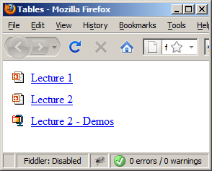
Simple HTML Tables – Example (2)
<table cellspacing="0" cellpadding="5">
<tr>
<td><img src="ppt.gif"></td>
<td><a href="lecture1.ppt">Lecture 1</a></td>
</tr>
<tr>
<td><img src="ppt.gif"></td>
<td><a href="lecture2.ppt">Lecture 2</a></td>
</tr>
<tr>
<td><img src="zip.gif"></td>
<td><a href="lecture2-demos.zip">
Lecture 2 - Demos</a></td>
</tr>
</table>

Slide 12
HTML Tables
Table rows split into three semantic sections: header, body and footer
<thead> denotes table header and contains <th> elements, instead of <td> elements
<tbody> denotes collection of table rows that contain the very data
<tfoot> denotes table footer but comes BEFORE the <tbody> tag
<colgroup> and <col> define columns (most often used to set column widths)

Slide 13
Complete HTML Table: Example
<table>
<colgroup>
<col style="width:100px" /><col />
</colgroup>
<thead>
<tr><th>Column 1</th><th>Column 2</th></tr>
</thead>
<tfoot>
<tr><td>Footer 1</td><td>Footer 2</td></tr>
</tfoot>
<tbody>
<tr><td>Cell 1.1</td><td>Cell 1.2</td></tr>
<tr><td>Cell 2.1</td><td>Cell 2.2</td></tr>
</tbody>
</table>
columns
header
th
footer
Last comes the body (data)

Slide 14
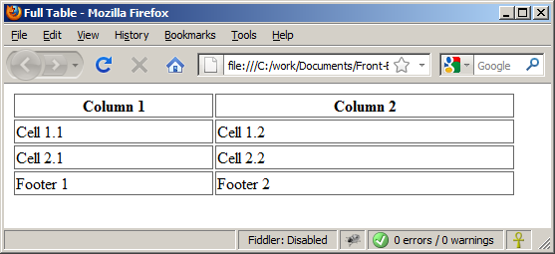
Complete HTML Table Example (2)
By default, header text is bold and centered.
table-full.html
<table>
<colgroup>
<col style="width:200px" /><col />
</colgroup>
<thead>
<tr><th>Column 1</th><th>Column 2</th></tr>
</thead>
<tfoot>
<tr><td>Footer 1</td><td>Footer 2</td></tr>
</tfoot>
<tbody>
<tr><td>Cell 1.1</td><td>Cell 1.2</td></tr>
<tr><td>Cell 2.1</td><td>Cell 2.2</td></tr>
</tbody>
</table>
Although the footer is before the data in the code, it is displayed last

Slide 15
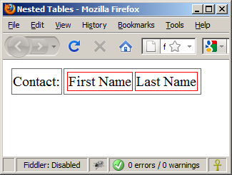
Nested Tables
Table data “cells” (<td>) can contain nested tables (tables within tables):
nested-tables.html
<table>
<tr>
<td>Contact:</td>
<td>
<table>
<tr>
<td>First Name</td>
<td>Last Name</td>
</tr>
</table>
</td>
</tr>
</table>

Slide 16
Cell Spacing and Padding
Tables have two important attributes:
cellspacing
Defines the empty space between cells
cellpadding
Defines the empty space around the cell content
cell
cell
cell
cell
cell
cell
cell
cell

Slide 17
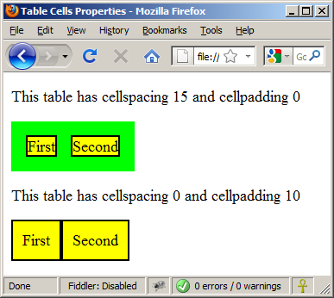
Cell Spacing and Padding – Example (2)
table-cells.html
<html>
<head><title>Table Cells</title></head>
<body>
<table cellspacing="15" cellpadding="0">
<tr><td>First</td>
<td>Second</td></tr>
</table>
<br/>
<table cellspacing="0" cellpadding="10">
<tr><td>First</td><td>Second</td></tr>
</table>
</body>
</html>

Slide 18
Column and Row Span
Table cells have two important attributes:
colspan
Defines how many columns the cell occupies
rowspan
Defines how many rows the cell occupies
colspan="1"
colspan="1"
rowspan="2"
rowspan="1"
cell[1,1]
cell[1,2]
cell[1,1]
cell[1,2]
cell[2,1]
cell[2,1]
colspan="2"
rowspan="1"

Slide 19
Column and Row Span –Example (2)
table-colspan-rowspan.html
<table cellspacing="0">
<tr class="1"><td>Cell[1,1]</td>
<td colspan="2">Cell[2,1]</td></tr>
<tr class=“2"><td>Cell[1,2]</td>
<td rowspan="2">Cell[2,2]</td>
<td>Cell[3,2]</td></tr>
<tr class=“3"><td>Cell[1,3]</td>
<td>Cell[2,3]</td></tr>
</table>
Cell[1,1]
Cell[2,1]
Cell[1,2]
Cell[2,2]
Cell[3,2]
Cell[1,3]
Cell[2,3]

Slide 20
SIMPLE EXAMPLE
<table>
<tr>
<th>Name</th>
<th>Favorite Color</th>
</tr>
<tr>
<td>Bob</td>
<td>Yellow</td>
</tr>
<tr>
<td>Michelle</td>
<td>Purple</td>
</tr>
</table>

Slide 21
Sample Code without Borders
<table>
<tr>
<td>Item A1</td>
<td>Item A2</td>
<td>Item A3</td>
</tr>
<tr>
<td>Item B1</td>
<td>Item B2</td>
<td>(this is B3)</td>
</tr>
<tr>
<td>Item C1</td>
<td>-C2-</td>
<td>*C3*</td>
</tr>
<tr>
<td>Item number D1</td>
<td>Item D2</td>
<td>Item D3</td>
</tr>
</table>
Item A1 | Item A2 | Item A3
Item B1 | Item B2 | (this is B3)
Item C1 | -C2- | *C3*
Item number D1 | Item D2 | Item D3

Slide 22
Do the following to this code
Add borders
Add cell padding
Add header

Slide 23
Table Creation-Exercise
Create a table as shown below using table tags
Slno | Course Code | Title | Credits
1 | 19CSE101 | CP | 3
2 | 19CSE103 | UID | 3
3 | 19CSE102 | DS | 2
4 | 19MAT100 | DM | 4

Slide 24
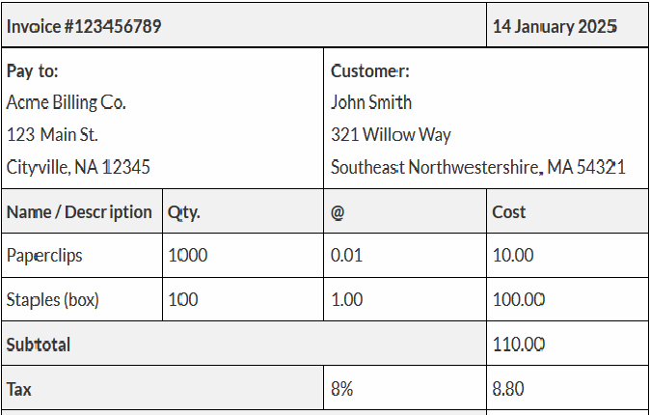
A complex table

Slide 25
Graphical User Interface Design
GUI / UI Design

Slide 26
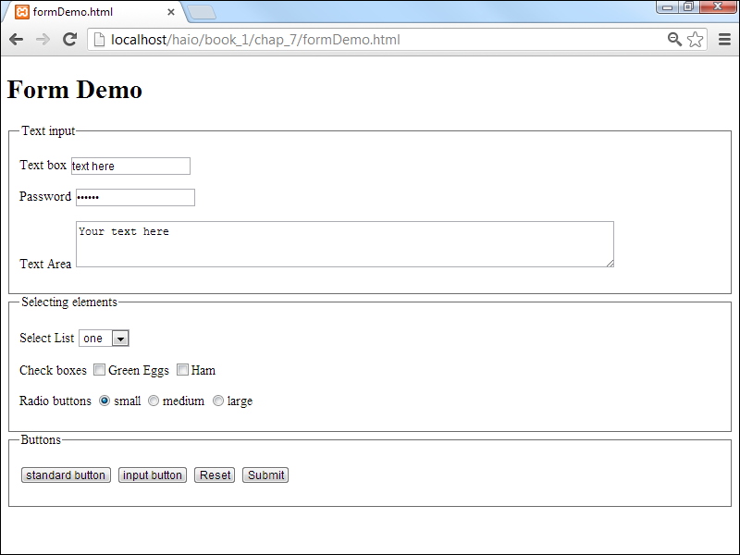
HTML - Forms

Slide 27
Why Forms?
Allows user to interact with data
Forms are used to create (rather primitive) GUIs on Web pages
Usually the purpose is to ask the user for information
The information is then sent back to the server
You can create forms with ordinary HTML, but to make them do something, you need a programming language – We shall look at Java Script for this later

Slide 28
What is a form?
A form is an area that can contain form elements
The syntax is: <form parameters> ...form elements... </form>
Form elements include: buttons, checkboxes, text fields, radio buttons, drop-down menus, etc
Other kinds of tags can be mixed in with the form elements
A form usually contains a Submit button to send the information in he form elements to the server
The form’s parameters tell JavaScript how to send the information to the server
Forms can be used for other things, such as a GUI for simple programs

Slide 29
Forms and JavaScript
The JavaScript language can be used to make pages that “do something”
You can use JavaScript to write complete programs, but...
Usually you just use snippets of JavaScript here and there throughout your Web page
JavaScript code snippets can be attached to various form elements
For example, you might want to check that a zipcode field contains a 5-digit integer before you send that information to the server
Microsoft calls its version of JavaScript “active scripting”
Forms can be used without JavaScript, and JavaScript can be used without forms, but they work well together
JavaScript for forms is covered later

Slide 30
Syntax
<form> . form elements . </form>
An HTML form contains form elements.
Form elements are different types of input elements, like text fields, checkboxes, radio buttons, submit buttons, and more.

Slide 31
The <form> tag
The <form arguments> ... </form> tag encloses form elements (and probably other elements as well)
The arguments to form tell what to do with the user input
action="url" (required)
Specifies where to send the data when the Submit button is clicked
method="get" (default)
Form data is sent as a URL with ?form_data info appended to the end
Can be used only if data is all ASCII and not more than 100 characters
method="post"
Form data is sent in the body of the URL request
Cannot be bookmarked by most browsers
target="target"
Tells where to open the page sent as a result of the request
target= _blank means open in a new window
target= _top means use the same window

Slide 32
Forms
The FORM element is used to create a data input form.
A region using forms is enclosed within the <FORM> </FORM> tags.
A document can have several forms, but the forms should not be embedded.
The FORM element has three attributes:
ACTION, METHOD, and ENCTYPE.

Slide 33
Forms
METHOD:
Specifies the way in which the data from the user are encoded.
The default METHOD is GET, although the POST method is preferred.
GET: The CGI program receives the encoded form input in the QUERY_STRING variable, which follows the “?” in the URL that calls the script.
POST: The CGI script or program receives the encoded form input in its standard input stream. The CONTENT_LENGTH must be used.

Slide 34
Forms
ACTION:
Specifies the destination URL to which the form should be submitted, once it has been completed by the user.
If no URL is specified, the URL of the current document containing the form is used.
MAILTO Action: The data from the form is mailed to the specified E-mail address. Use the POST method.

Slide 35
Forms
ENCTYPE:
Tell the browser how the data from a form should be encoded when it is returned to the server.
The default is “application/x-www-form-urlencoded” that converts spaces to “+” and uses “&” to delineated different data fields.

Slide 36
Form Processing
B
r
o
w
s
e
r
HTML
Form
Input
Data from
Form
User
Data from
Form
Web
Server
Form
Processing
Program
(CGI)
HTML
Document
Output
Data
Flow
HTML
Document
Database
Management
System
Flow of Information for Forms

Slide 37
Form Elements
A form: A container for form elements. Although the form element itself isn’t usually a visible part of the page (like the body tag)
Text boxes: These standard form elements allow the user to type text into a one-line element.
Password boxes: These boxes are like text boxes, except they automatically obscure the text to discourage snooping.
Text areas: These multi-line text boxes accommodate more text than the other types of text boxes. You can specify the size of the text area the user can type into.
Select lists: These list boxes give the user a number of options. The user can select one element from the list. You can specify the number of rows to show or make the list drop down when activated.

Slide 38
Form Elements
Check boxes: These non-text boxes can be checked or not. Check boxes act independently — more than one can be selected at a time (unlike radio buttons).
Radio buttons: Usually found in a group of options, only one radio button in a group can be selected at a time. Selecting one radio button deselects the others in its group.
Buttons: These elements let the user begin some kind of process. The Input button is used in JavaScript coding whereas the Submit buttons are used for server-side programming The Reset button is special because it automatically resets all the form elements to their default configurations.

Slide 39
The <input> tag
The <input> Element
The <input> element is the most important form element.
The <input> element can be displayed in several ways, depending on the type attribute.
Most, but not all, form elements use the input tag, with a type="..." argument to tell which kind of element it is
type can be text, checkbox, radio, password, hidden, submit, reset, button, file, or image
Other common input tag arguments include:
name: the name of the element
id: a unique identifier for the element
value: the “value” of the element; used in different ways for different values of type
readonly: the value cannot be changed
disabled: the user can’t do anything with this element
Other arguments are defined for the input tag but have meaning only for certain values of type

Slide 40
TYPE Attribute
TEXT type:
Specifies a single line text entry field.
Can be used with the MAXLENGTH and SIZE attributes (MAXLENGTH >= SIZE)
<P><B> First Name:</B> <INPUT NAME=“fname” TYPE = text MAXLENGTH=30 SIZE =30></P>
<P><B> Last Name:</B> <INPUT NAME=“lname” TYPE = text MAXLENGTH=30 SIZE =30></P>

Slide 41
Text input
A text field:
<input type="text" name="textfield" value="with an initial value" />
A multi-line text field
<textarea name="textarea" cols="24" rows="2">Hello</textarea>
A password field:
<input type="password" name="textfield3" value="secret" />
• Note that two of these use the input tag, but one uses textarea

Slide 42
Buttons
A submit button: <input type="submit" name="Submit" value="Submit" />
A reset button: <input type="reset" name="Submit2" value="Reset" />
A plain button: <input type="button" name="Submit3" value="Push Me" />
submit: send data
reset: restore all form elements to their initial state
button: take some action as specified by JavaScript
• Note that the type is input, not “button”

Slide 43
Radio buttons
Radio buttons:<br> <input type="radio" name="radiobutton" value="myValue1" /> male<br> <input type="radio" name="radiobutton" value="myValue2” checked="checked" />female
If two or more radio buttons have the same name, the user can only select one of them at a time
This is how you make a radio button “group”
If you ask for the value of that name, you will get the value specified for the selected radio button
As with checkboxes, radio buttons do not contain any text

Slide 44
Labels
In many cases, the labels for controls are not part of the control
<input type="radio" name="gender" value="m" />male
In this case, clicking on the word “male” has no effect
A label tag will bind the text to the control
<label><input type="radio" name="gender" value="m" />male</label>
Clicking on the word “male” now clicks the radio button
w3schools says that you should use the for attribute:
<label for="lname">Last Name:</label> <input type="text" name="lastname" id="lname" />
In my testing (Firefox and Opera), this isn’t necessary, but it may be for some browsers
Labels also help page readers read the page correctly
Some browsers may render labels differently

Slide 45
Checkboxes
A checkbox: <input type="checkbox" name="checkbox" value="checkbox" checked="checked">
type: "checkbox"
name: used to reference this form element from JavaScript
value: value to be returned when element is checked
Note that there is no text associated with the checkbox
Unless you use a label tag, only clicking on the box itself has any effect

Slide 46
Drop-down menu or list
A menu or list: <select name="select"> <option value="red">red</option> <option value="green">green</option> <option value="BLUE">blue</option> </select>
Additional arguments:
size: the number of items visible in the list (default is "1")
multiple
if set to "true" (or just about anything else), any number of items may be selected
if omitted, only one item may be selected
if set to "false", behavior depends on the particular browser

Slide 47
Hidden fields
<input type="hidden" name="hiddenField" value="nyah"> &lt;-- right there, don't you see it?
What good is this?
All input fields are sent back to the server, including hidden fields
This is a way to include information that the user doesn’t need to see (or that you don’t want her to see)
The value of a hidden field can be set programmatically (by JavaScript) before the form is submitted

Slide 48
Forms - Example
<html> <head> <title>Get Identity</title> </head> <body> <p><b>Who are you?</b></p> <form method="post" action=""> <p>Name: <input type="text" name="textfield"> </p> <p>Gender: <label><input type="radio" name="gender" value="m" />Male<label> <label><input type="radio" name="gender" value="f" />Female</label> </p> </form> </body> </html>

Slide 49
Forms
Form Input: INPUT
Only used within a FORM element and is denoted by <INPUT>.
Attributes:
NAME: The name of the particular element.
MAXLENGTH: The maximum number of characters that can be entered by users in a text field.
SIZE: Specifies the size of the field and depends on its type.
SRC: Denote URL for an image.
VALUE: Contain the initial value displayed to users.
TYPE: Defines the type of data used in the field.
CHECKED: Indicates that a checkbox or radio button is selected.
DISABLED: Prevents the field from receiving focus.
ALIGN: Alignment if image is used.
READONLY: Prevents modification of the contents of the field.

Slide 50
TYPE Attribute
SUBMIT and RESET Types:
SUBMIT: Used to submit the form’s content, as specified by the ACTION attribute.
RESET: Set all fields in the form to their initial values.
<P>INPUT TYPE=SUBMIT>
<INPUT TYPE=RESET>
<P><INPUT TYPE=SUBMIT VALUE = “Place Your Order”>
<INPUT TYPE=RESET VALUE = “Start over”>

Slide 51
TYPE Attribute
BUTTON Input Type:
Creates a button whose use can be defined through scripting and onClick event.
Use to create a back button.
Only useful to browsers that support scripting.
<FORM><P><INPUT TYPE=“button” VALUE=“Back to Last Document” onClick=“history.back( )”></P></FORM>

Slide 52
TEXTAREA
Let users enter more than one line of text.
Uses attributes ROWS and COLS to size.
WRAP Attribute:
OFF: No wrapping
VIRTUAL: Display wraps but long lines are sent as one line.
PHYSICAL: Word wraps and text is sent with wrap points.

Slide 53
More on Forms - More input elements
Date -- Setting the input type to date indicates that you wish the user to enter a date value.
Tag: <input type="date“ id = "date" />
Usage: <p> Date: <label>
<input type="date" id="date" />
</label></p>
Time -- input type is to allow the user to enter a time. Time is stored in hh:mm format
Tag: <input type = "time” id = "time" />
Usage:<p> Time: <label>
<input type="time" id="time" />
</label></p>

Slide 54
More form tags …
Datetime -- combines date and time into a single element
Number -- allows the input of numerical data. This often consists of a text field followed by some kind of selector (say up and down arrows), or it might change the virtual keypad of a portable device to handle only numeric input.
Tag: <input type = "number“ id = "number“ max = "10“ min = "0" />
Usage: <p> Number: <label> <input type = "number“ id = "number“ max = "10“ min = "0" /></label> </p>

Slide 55
Some More ….
Email -- generally looks like a plain text field, but it validates on an e-mail address
<input type="email” id = "txtEmail" />
Usage:<p> Email: <label>
<input type = "email“ id = "txtEmail“ /></label> </p>

Slide 56
HTML <audio> Element
<audio controls> <source src="horse.ogg" type="audio/ogg"> <source src="horse.mp3" type="audio/mpeg"> Your browser does not support the audio element. </audio>
The controls attribute adds audio controls, like play, pause, and volume.
The <source> element allows you to specify alternative audio files which the browser may choose from. The browser will use the first recognized format.
The text between the <audio> and </audio> tags will only be displayed in browsers that do not support the <audio> element.

Slide 57
<video> tag
<video> element specifies a standard way to embed a video in a web page
<video width="320" height="240" controls> <source src="movie.mp4" type="video/mp4"> <source src="movie.ogg" type="video/ogg"> Your browser does not support the video tag. </video>
The controls attribute adds video controls, like play, pause, and volume.
Always include width and height attributes. If height and width are not set, the page might flicker while the video loads.
The <source> element allows you to specify alternative video files which the browser may choose from. The browser will use the first recognized format.
The text between the <video> and </video> tags will only be displayed in browsers that do not support the <video> element.

Slide 58
Input Types … a glance
<input type="button">
<input type="checkbox">
<input type="color">
<input type="date">
<input type="datetime-local">
<input type="email">
<input type="file">
<input type="hidden">
<input type="image">
<input type="month">
<input type="number">
<input type="password">
<input type="radio">
<input type="range">
<input type="reset">
<input type="search">
<input type="submit">
<input type="tel">
<input type="text">
<input type="time">
<input type="url">
<input type="week">

Slide 59
HTML Input - value Attribute
The readonly attribute specifies that the input field is read only
The disabled attribute specifies that the input field is disabled. -- A disabled input field is unusable and un-clickable, and its value will not be sent when submitting the form
size attribute specifies the size (in characters) for the input field
maxlength attribute specifies the maximum allowed length for the input field

Slide 60
HTML 5 Does not end here…
More Tags.. More Tags..
More and More of attributes..

